Slide 1
Policy, Practice and Problems:
UK university cultures and responses to open access
Gaz J Johnson
Nottingham Trent University
OER14, Newcastle, April 2014
gareth.johnson2012@my.ntu.ac.uk
@llordllama

Slide 2
Background
Current UK environment has brought scholarly dissemination issues into sharp focus
  REF 2014, HEFCE & RCUK Policies, House of Lords Inquiry
  Emerging technological disruption to publishing industry
Prior practitioner experiences raised a question
  If the principles of an open scholarly commons are such a self-evident societal good why are so many UK academics so reluctant to engage?
Perceived indifferent academic cultural response
  Prior research focus on quantitative metrics and technological solutions
  Influence actors power structures poorly understood
  Little work focussing on cultural barriers and behaviour

Slide 3
Research Methods
Ethnographic and qualitative framed cultural research
  Cultural lens offers a holistic, rich and multi-faceted account
UK academic engagement with the open intellectual commons and evidenced cultural differences
  Deepen understanding of power and influence relationships impacting on academics
  Different types of UK HE institutional cultures promotion of OA engagement
  Hoped contribute towards achieving sustainable academic cultural change
Philosophical underpinnings in understand motivations, behaviours and relationships
  Foucault, (neo)Marxist analysis & emerging neoliberal critique
  Critical management and organisational studies for examination of institutional culture
  Possible interest in Deleuze, Guattari and Latour on power and networks

Slide 4
Scoping the UK OA Field
Establish a grounding of OA engagement within UK HEIs
  Provide context and contrast for later work
  Semi-structured qualitative interviews
  Targeted representative OA workers at UK HEIs
Key thematic areas
  Activities: origins and current broad OA related activities
  Engagement: academic and institutional engagement
  Influence: actors and driving agencies
  Obstacles: challenges and barriers

Slide 5
Sample Spread
125 HEIs approached
  81 institutions interviewed
  27.5hrs audio, approx. 220k words
Representation
  Russell Group: 88%
  1994 Group: 91%
  Million+ 45%
  Cathedrals Group 47%
  University Alliance 63%
  Other 36%
Qualitative content transcript analysis

Slide 6
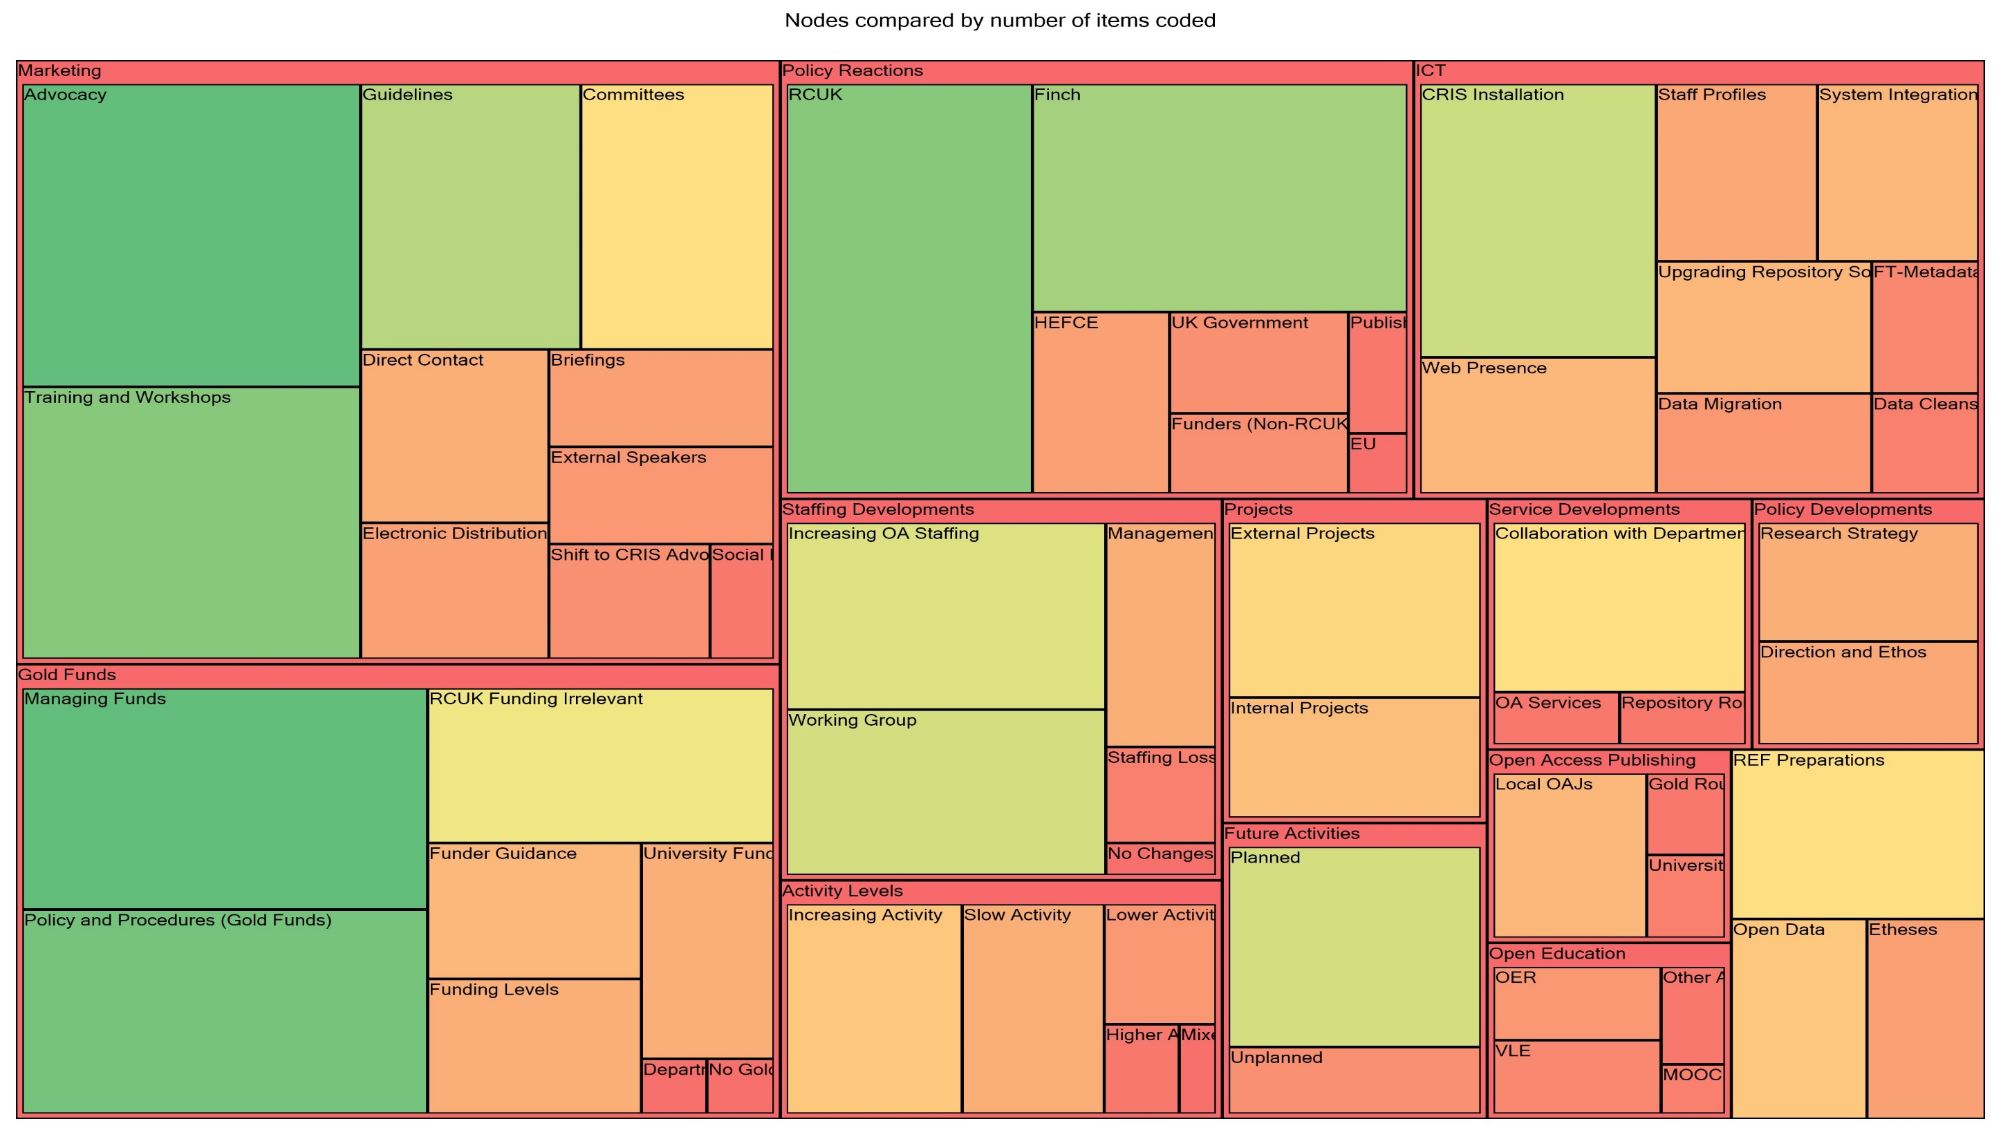
Recent Activity Focus

Slide 7
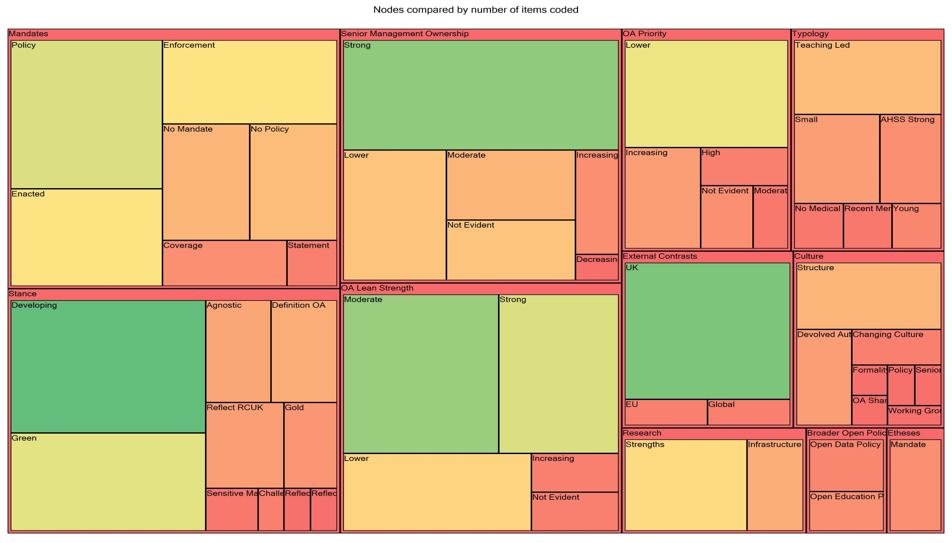
Policy Issues

Slide 8
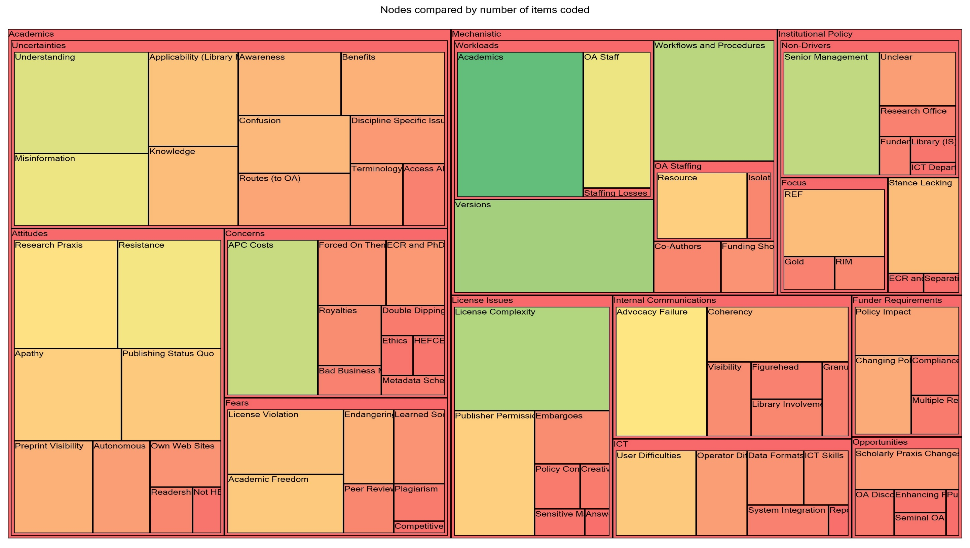
Barriers to OA Progression

Slide 9
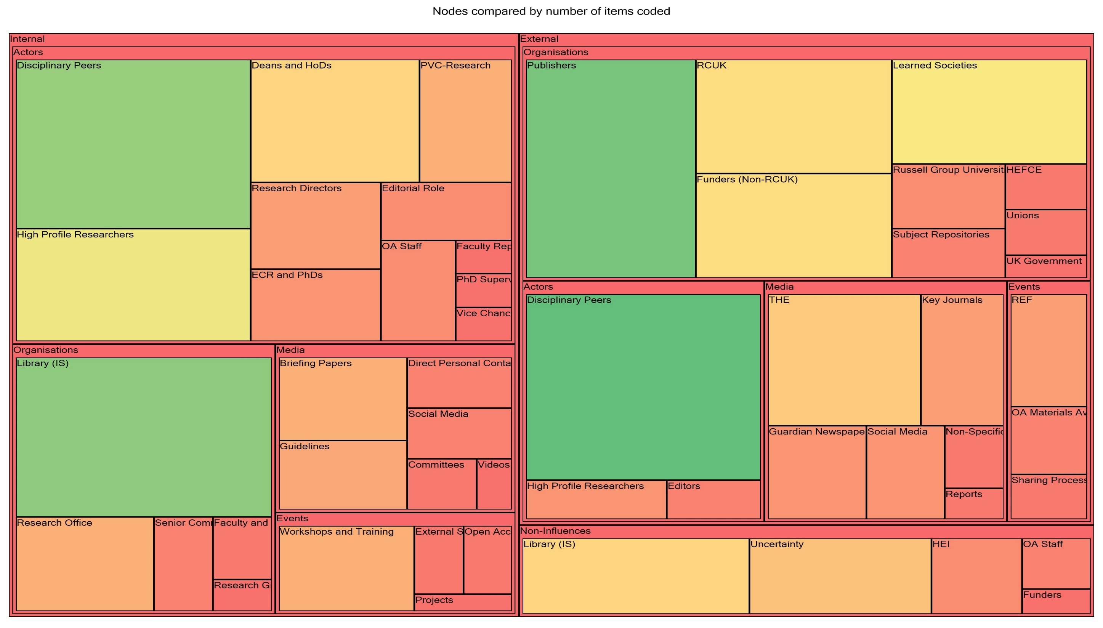
Influence Actors

Slide 10
Next Steps
Contextualisation and detailed investigations
  Interviews with identified key influence actors & academics drawing on themes identified
  Crucially identify any critical dysfunctions and misapprehensions
  3-4 case studies at disparate HEIs across the UK
Neoliberal UK HE critique
  An increasingly marketised, commodified knowledge/learning regime
  Subsumption of HE discourse framed within the language of business and management
  Impact and cultural resistance to neo-Taylorist managerliasm and measure
  Policy driven by productivity and efficiencies focus emphasises STEM over AHSS
  Not why hasn't open access made more of an impact, but how has it managed to make any impact at all in a marketised education sector?

Slide 11
Contact
gareth.johnson2012@my.ntu.ac.uk
@Llordllama
nottinghamtrent.academia.edu/GarethJohnson
Funding acknowledgement to AHRC

